Slide 1
Retrieval Augmented Generation (RAG) Challenge
Dylan Rodriguez Flores
Dan Bigman

Slide 2
Objectives
Acquire hands-on experience in implementing a RAG system.
Dataset selection and normalization
Connection to external artefacts (VectorDB, APIs)
Gaining a comprehensive understanding of RAG’s components and their integration.
Notes:
Develop slides that cover:
Introduction and project objectives.
Key steps and methodologies.
Visualizations from the EDA.
Examples of retrieval and generated responses.
Evaluation results and conclusions.
Bonus: Incorporate a live demo if possible.

Slide 3
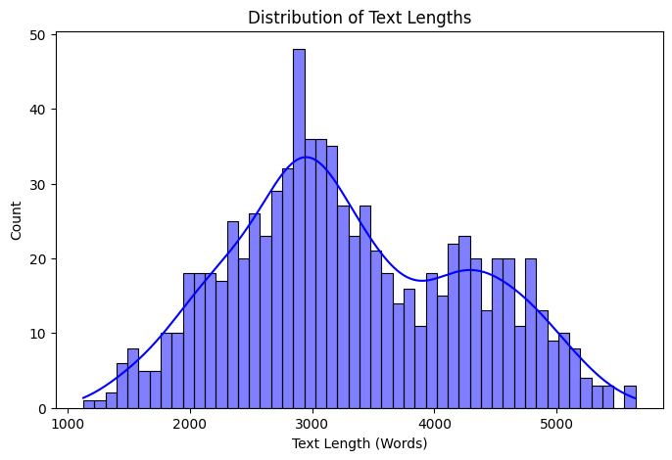
Exploratory Data Analysis
Examine data structure, formats, and metadata.
Identify any missing values, duplicates, or inconsistencies.
Data Cleaning & Preprocessing
Normalize data

Slide 4
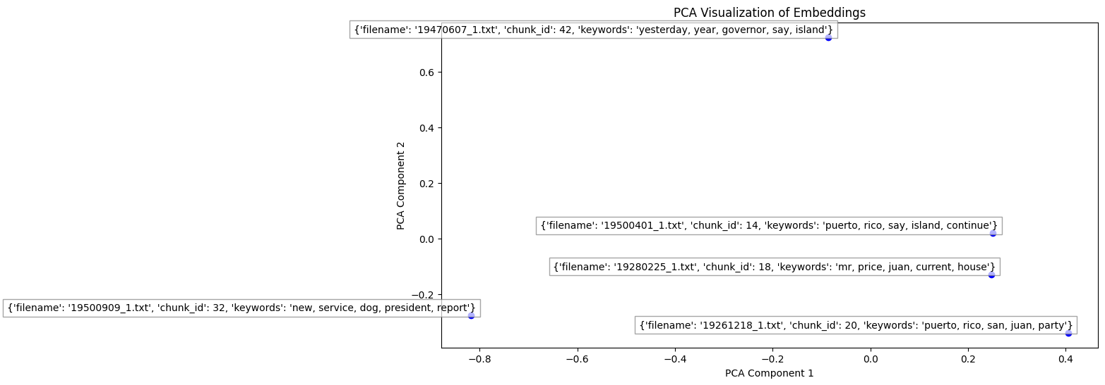
Otra gráfica que queramos enseñar
We took 5 random samples and used PCA. Each point is a chunk from the text of different files. We can visualize relationships between chunks.
This visualization shows text similarity, showing recurring themes like “Puerto Rico”, “San Juan”, “island”.

Slide 5
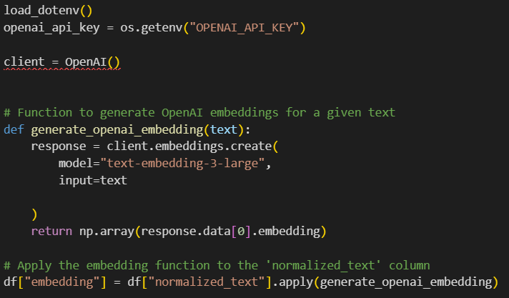
Key steps and Methodologies
01
Embedding and Storing Chunks:
Generate Document Embeddings
Connect to a Vector Database
Integration Frameworks
02
Connecting to LLM:
LLM Selection & Setup
Integration Workflow
Notes:
We used RecursiveCharacterTextSplitter to divide into manageable chunks (500 characters with 50 characters overlap). This ensures each chunk is meaningful and avoids cutting off critical information.
We used OpenAI model="text-embedding-3-large" to generate embeddings and save them in a .pkl file.

Slide 6

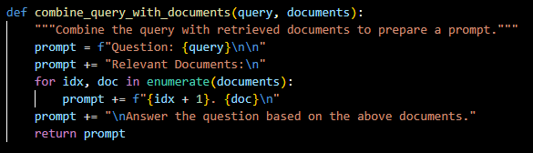
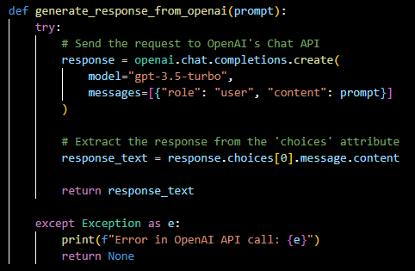
LLM Selection
We chose OpenAI LLM API for Q&A
The function generate_response_from_openai sends the constructed prompt to OpenAI’s API endpoint.
By including retrieved documents as part of the prompt, the LLM is better quality and can generate answers that are directly tied to the external content.

Slide 7
Test Prompts
Prompt(19501230):
What did the cobalt rationing cause?
Expected output:
Affect the production of radios, television receivers and other household appliances.
Actual Output: The cobalt rationing caused significant disruption to the production of radios, television receivers, and other household appliances. It also affected the defense program and essential civilian products that rely on cobalt.
Prompt(195000909)
What places did the American officers expected the communists to attack?
Expected output:
The American officers expected the communists to attack near Hamhung, on the beachhead of the Orient coast.
Actual output: The American officers expected the communists to attack near Hamhung, on the beachhead of the Orient coast, where twenty thousand infantry and soldiers were advancing under a Communist encirclement. Reports indicated that a Chinese army, potentially numbering one million troops, was maneuvering rapidly to deliver a decisive blow to the U.S. Eighth Army in the West and the U.S. Tenth Corps in the East. General Douglas MacArthur's offensive was aimed at challenging Communist China to openly commit its armies or to force them to withdraw from Korea.

Slide 8

Thank you!

